Slide 1
Lecture 22 Frequency Response
Hung-yi Lee

Slide 2
Outline (Chapter 11)
Frequency Response
Amplitude
Ratio
Phase
Shift
Ch 11.1
Filter
Lowpass
Filter
Highpass
Filter
Bode
Plot
Ch 11.4
Ch 11.2
Bandpss
Filter
Notch
Filter
Draw frequency response

Slide 3
Review
Network Function
Network Function
Output depends on input and complex frequency s.

Slide 4
Frequency Response
In this lecture, we only focus on s=jω.
That is, only consider H(jω)
Only focus on the change of frequency
H(jω) is the frequency response.

Slide 5
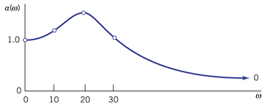
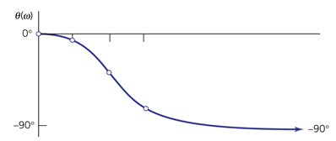
Frequency Response
H(jω) is a complex number, so frequency response is usually represented by two curves
Magnitude Ratio
Phase
Shift

Slide 6
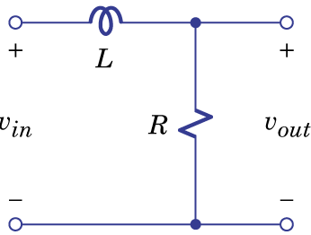
Example 11.1
Network Function:
Frequency Response:

Slide 7
Example 11.1
Based on Superposition:

Slide 8
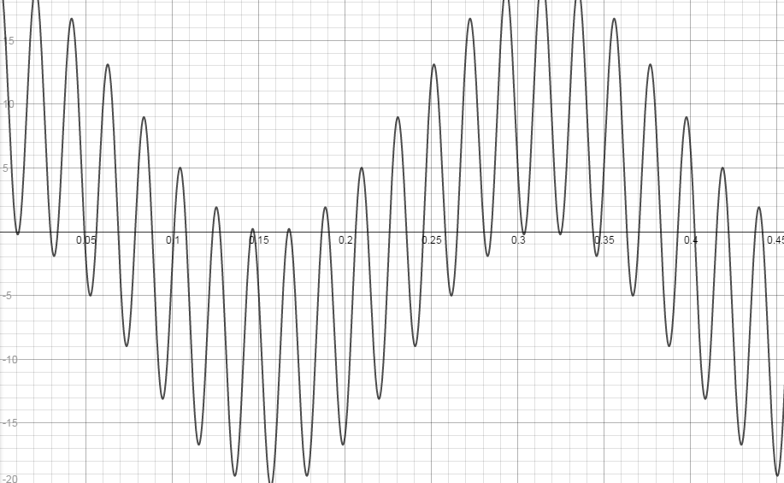
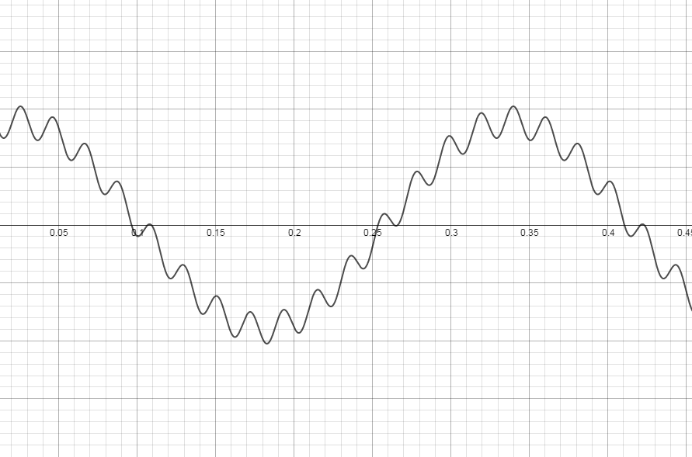
Example 11.1
Input
Output

Slide 9
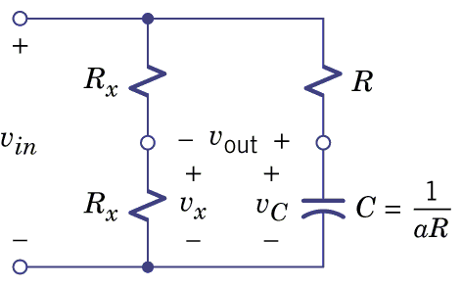
Example 11.2
Find Network Function
Assume C=1/aR
a=1/RC

Slide 10
Example 11.2
Set s=jω
The amplitude ratio is constant.
Notes:
Draw tan-1

Slide 11
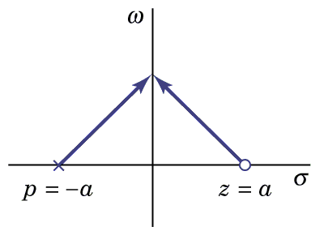
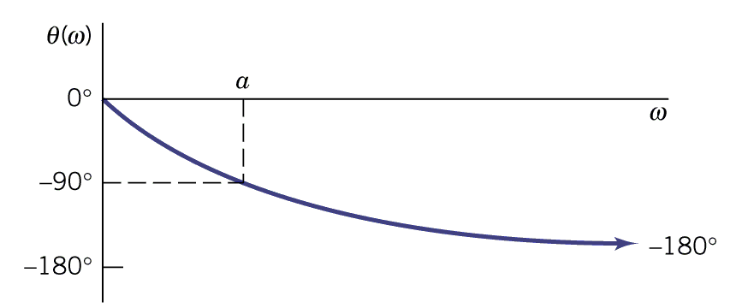
Example 11.2
Distance of jω to a
Magnitude Ratio
Distance of jω to -a
Phase Shift

Slide 12
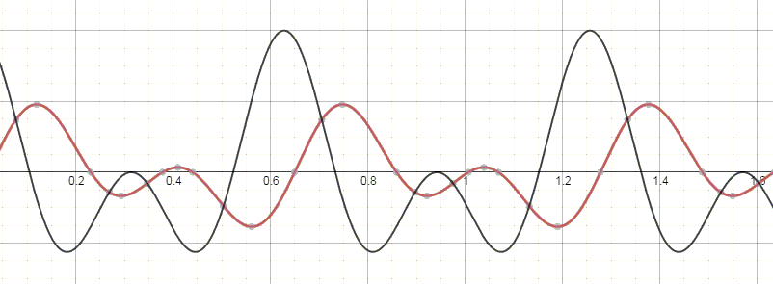
Example 11.2
Phase shift network: Waveform distortion

Slide 13
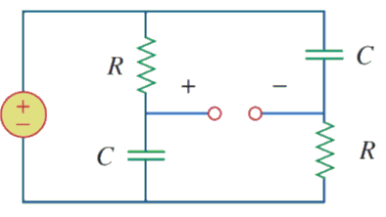
Another Example for Phase Shift Network

Slide 14
Another Example for Phase Shift Network

Slide 15
Computing Frequency Response by Poles and Zeros

Slide 16
Frequency Response
K: gain factor
p₁, p₂, …: poles
z₁, z₂, …: zeros

Slide 17
Frequency Response - Magnitude Ratio
Distance of jω to z₁
Distance of jω to z₂
Distance of jω to p₁
Distance of jω to p₂

Slide 18
Frequency Response - Magnitude Ratio
Magnitude ratio at ω
=| Gain factor|
all distance to zeros
X
all distance to poles
Gain factor is K

Slide 19
Frequency Response - Phase Shift

Slide 20
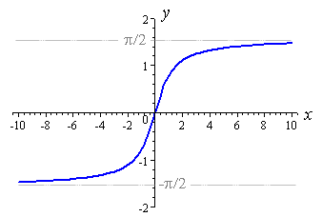
Example 11.3

Slide 21
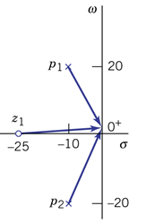
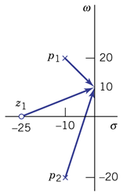
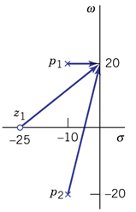
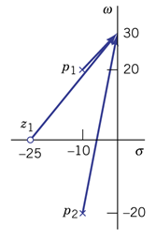
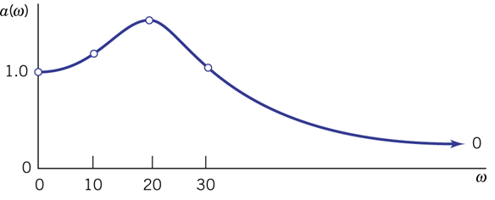
Example 11.3

Slide 22
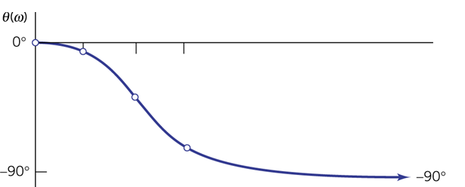
Example 11.3

Slide 23
Homework
11.2, 11.4

Slide 24
Application: Hearing
Reference: http://hyperphysics.phy-astr.gsu.edu/hbase/sound/hearcon.html

Slide 25
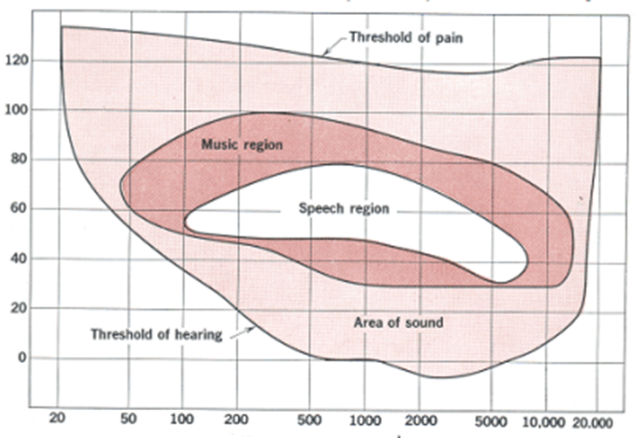
Range of Hearing
Range of hearing: 20Hz - 20KHz
Range of Audio: 300Hz – 3.4KHz
dB
Frequency
Notes:
dialup

Slide 26
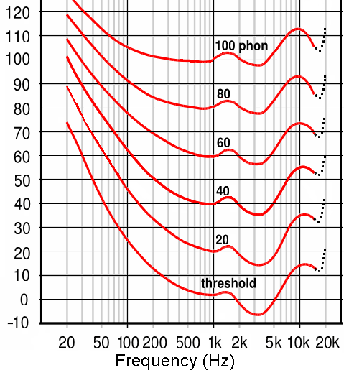
Equal Loudness Contour
Blue Line:
Same Energy
dB
Red Curve:
Equal loudness
phon (unit):
60 phon means as loud as the 60dB 1kHz sound.
Notes:
唪 三聲

Slide 27
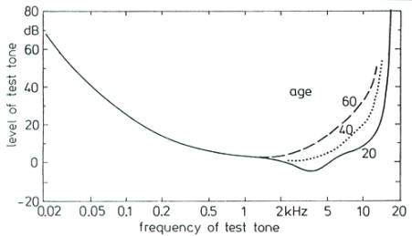
Hearing v.s. Age
Application: 柯南 68 集 (黑暗中消失的麒麟之角)

Slide 28
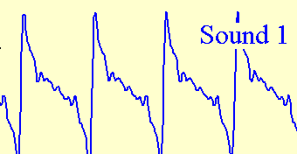
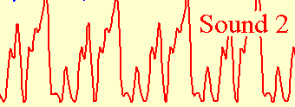
Phase and Sound
Pass a Phase shift network
Notes:
We do not recognize speech by waveform
We recognize speech by frequency compoenent

Slide 29
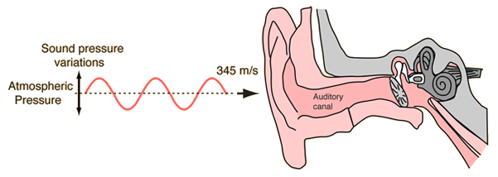
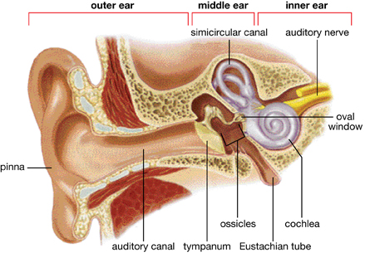
Structure of Ear
Notes:
錘 砧 鐙

Slide 30
Cochlea (耳蝸)
Each neuron only passes a specific frequency.
Pass 20kHz
Pass 20Hz
to brain
Pass high
frequency
Pass low
frequency
Notes:
Frequency vs age

Slide 31
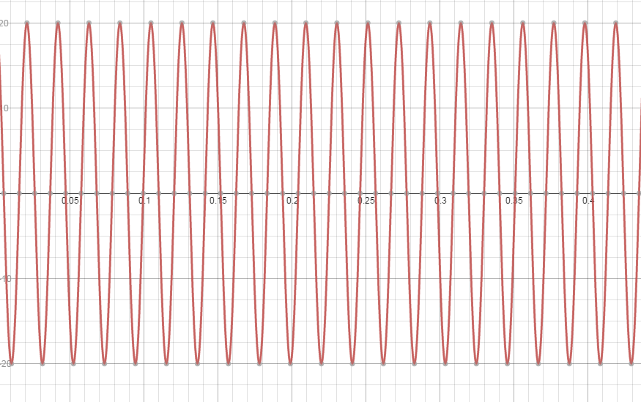
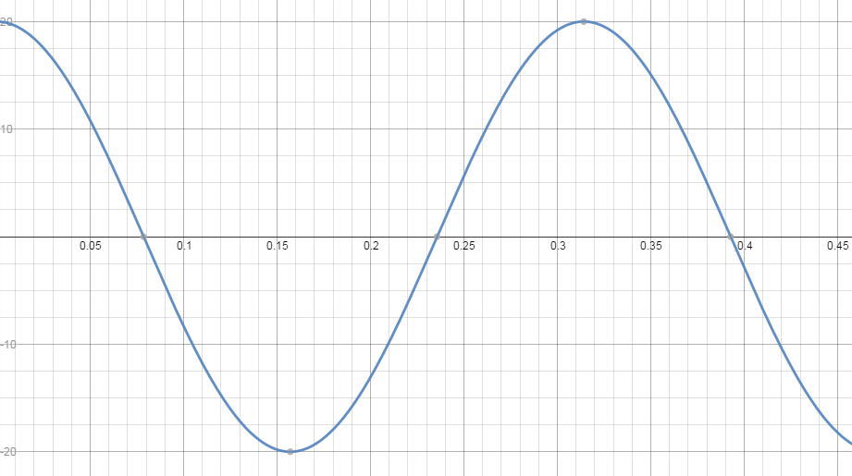
Cochlea (耳蝸)
ω=300, Amplitude=10
ω=20, Amplitude=10
to brain
Neuron for
ω=300
Neuron for ω=100
Neuron for ω=20
Notes:
Examples
Why Frequency vs age
Why loudness graph

Slide 32
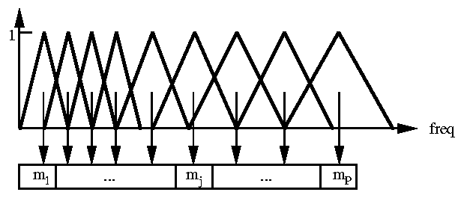
Machine Hearing
How?
A set of filters (filter bank)
Each triangle is the amplitude ratio of a filter
Ear of machine
Energy of the signal of the output of the filter
Feature
Send to computer
How to write a program for speech recognition?
a. Observe data, and write down some rules
b. Simulate human brain, and let the computer learn by itself.

Slide 33
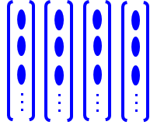
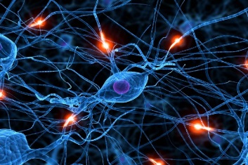
Speech
Signal
Signal Processing
(Filter Bank)
Features
Machine Learning
Acoustic
Model
ㄨㄣˊ ㄧˋ …
文藝?
Language
Model
Deep Neural Network (Brain)
聞腋?
Text
Speech Recognition

Slide 34
Thank you!

Slide 35
Answer
11.2:
11.4:

Slide 36
Acknowledgement
感謝 陳俞兆(b02)
上課時指出投影片的錯誤
感謝 陳均彥(b02)
上課時指出投影片的錯誤
感謝 林楷恩(b02)
指出投影片方程式的錯誤

